Slide 1
Information Retrieval
Set/String Similarity, MinHash & LSH
Introduction to Deep Learning: Class 4.3

Slide 2
Module Agenda
IR problem setup and evaluation
Lexical Retrieval and Classic Sparse Indices
Set/String Similarity
Minhash
LSH
Semantic Similarity and Dense Retrieval
Indexing for Fast ANN
HNSW, IVF, PQ
Sparse Neural Retrieval
Splade, Hybrid search
Rank fusion and re-ranking

Slide 3
Preread
Locality Sensitive Hashing 1: https://web.stanford.edu/class/cs246/

Slide 4
Beyond exact term matching..
So far, our document similarity measures TF-IDF, BM25 etc are based on exact string matching. Practical applications require more fuzziness, at the word level--catch words that are very similar, but not identical, and at the document level--detect documents that are near duplicates
Need measures of “how close” two strings/sets are
Let’s first consider string matching, then set matching.

Slide 5
Approximate string matching
How similar are two strings?
Edit distance: minimum single-character edits (addition, deletion, substitutions) required to transform one string to another
s1=”sitting”, s2=”kitten”. s->k, i->e, add g. Edit distance = 3. Efficiently calculated using Dynamic Programming
Longest Common Subsequence (LCS) eg., “itt” for above example
Jaccard distance (1-IoU) between character n-grams
3-grams (s1): {sit,itt, tti, tin, ing}, 3-grams (s2): {kit, itt, tte, ten}
Jaccard distance: 1-⅛=7/8
Phonetic algorithms: match words based on how they sound in a particular language, regardless of spelling. Eg., soundex
“Smith” -> S530, “Smyth” -> s530

Slide 6
Set matching
How similar are two documents?
d1: deep learning neural networks
d2: deep learning models
d3: pizza pasta tiramisu
Query: deep neural models
A good way of measuring similarity is overlap.

Slide 7
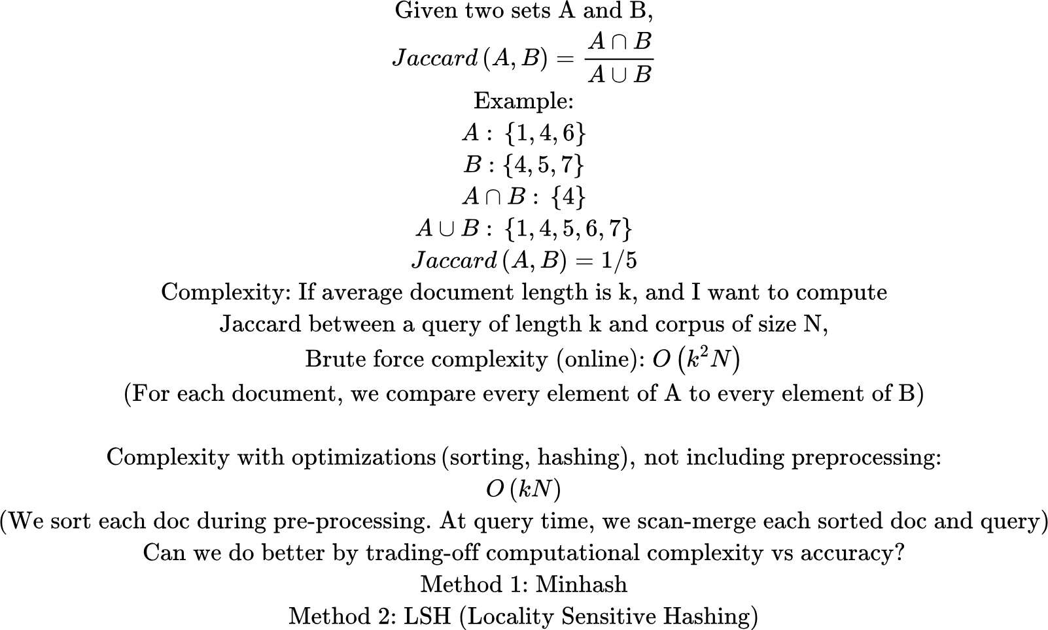
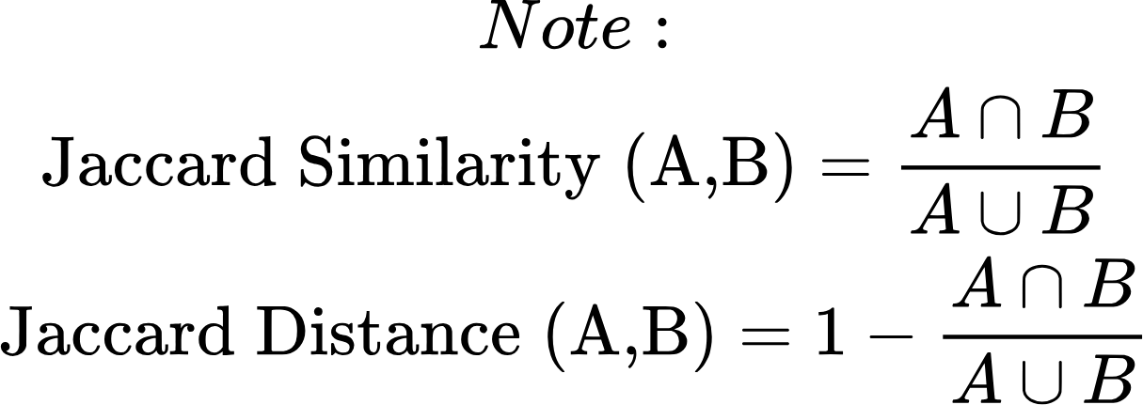
Measuring Overlap

Slide 8
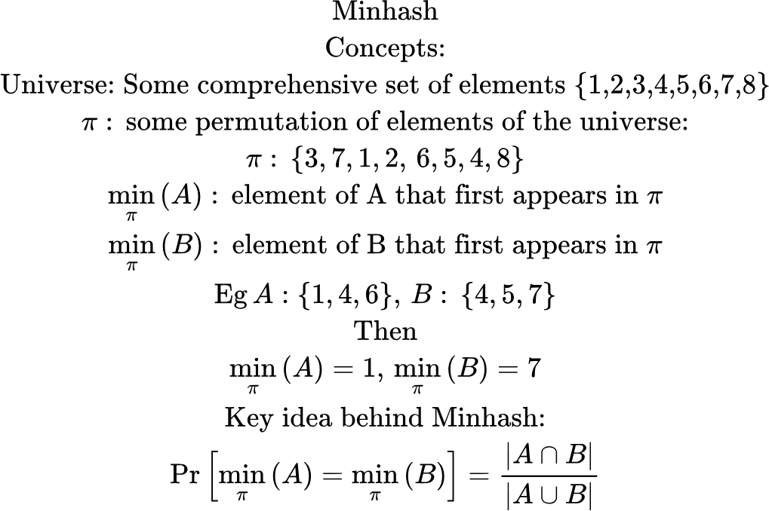
Minhash

Slide 9
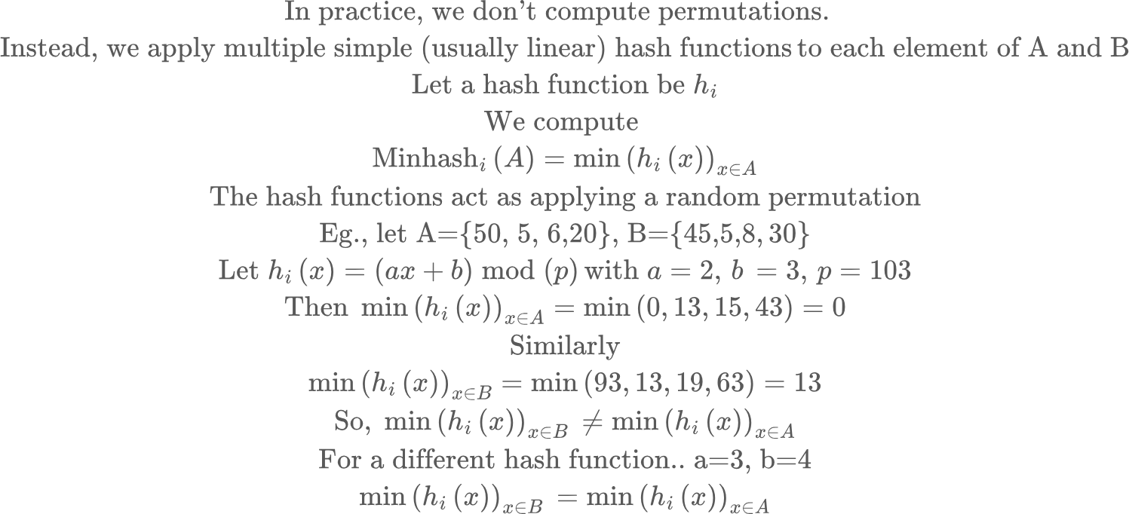
Minhash

Slide 10
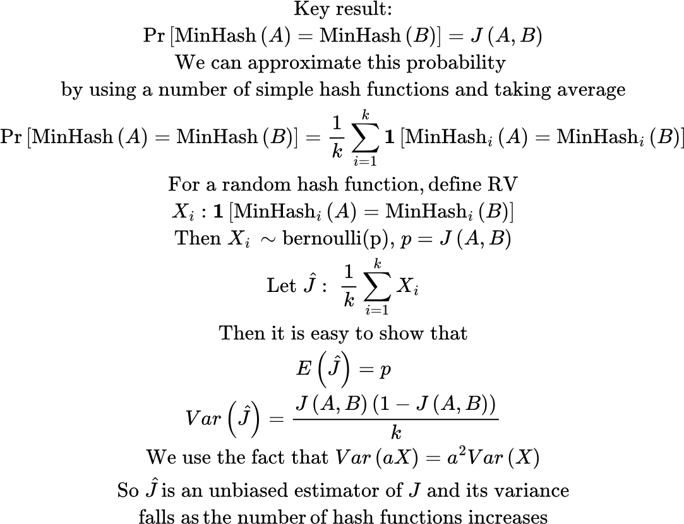
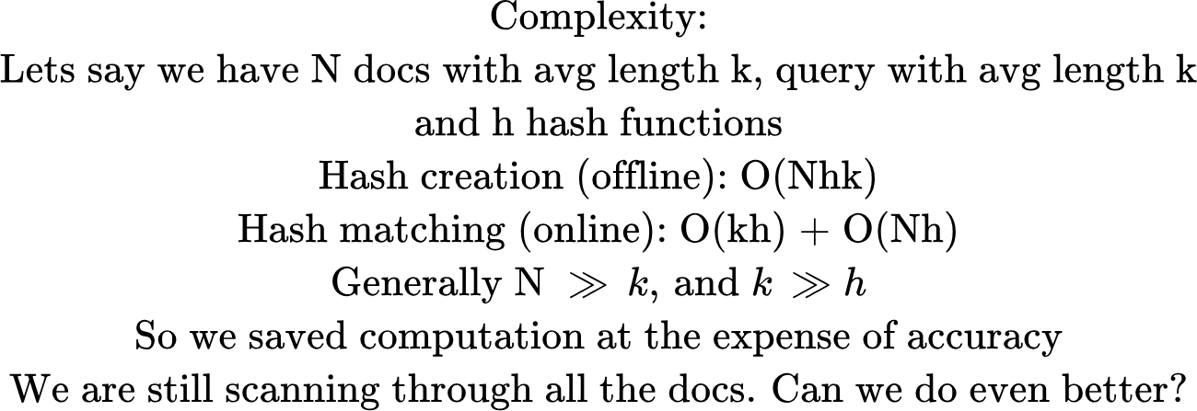
Minhash
min_hash.py shows how min_hash approximation of J improves with number of permutations

Slide 11
Minhash
s_1
s_2
…
s_h
Document 1
h1
Best
hikes
near
San
Francisco
minhash
2
5
7
10
12
s_1
s_2
…
s_h
h2
overlap
Tokenize
…
overlap
s_1
s_2
…
s_h
hh
Signature Vector
Query
Document N
Generally the number of hashes << doc length, so a signature vector is a lot shorter than a typical doc

Slide 12
LSH
Minhash gives us a short signature vector, where fraction of equal components ~ Jaccard distance between query and document. However computing Jaccard similarity over the entire corpus still requires repeating this operation over all documents.
LSH is used to get promising document candidates in sub-linear time. Key idea is to split the signature vector into buckets and hash each bucket’s signatures. At query time, compare the hashes. If any of the hashes match, the document is added to the candidate set.

Slide 13
LSH
Candidate pair: two docs that share a hash in at least one band
Approach: For each doc, in each band, hash the band’s subvector to a bucket
For each query, compute minhash signature, divide into bands, compute hash for each band and look up docs for the hash. Only compute full similarity for candidate docs.
hash 1
hash 2
hash n1
{d1, d3, d8}
s_1
s_2
s_3
s_4
s_5
s_6
Best
hikes
near
San
Francisco
{d4, d5, d9}
Tokenize + hash
hash(s_1, s_2, s_3)
Band 1
Band 2
hash 1
hash 2
hash n2
hash(s_4, s_5, s_6)
Query
Split a signature vector of size n into b buckets (bands) of size r (rows). Eg., n = 6, b = 2, r = 3

Slide 14
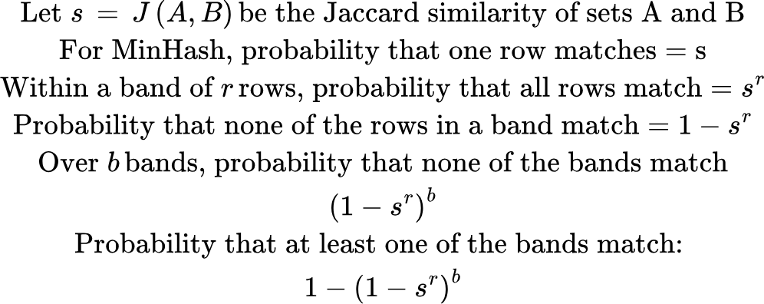
LSH: Analysis

Slide 15
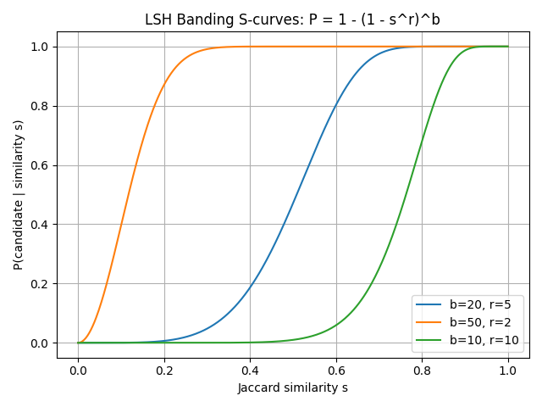
LSH Banding S-curves
Less selective
More selective

Slide 16
Minhash + LSH pipeline
Preprocessing:
For each document,
Compute Minhash signature vector
Divide into bands, build LSH table for each band
At query time
For each query
Compute Minhash signature vector O(hk)
Divide into bands, compute hash. Look up candidate docs in LSH table
Rescore candidates with BM25, embeddings etc.

